Slide 1
Data Science
Session – 15
Date – 16th June, 2022

Slide 2
Why do we need Inferential Statistics?
Suppose, we want to know the average salary of Data Science professionals in India. We have following methods can be used to calculate it?
Meet every Data Science professional in India. Note down their salaries and then calculate the total average?
Or hand pick a number of professionals in a city like Gurugram. Note down their salaries and use it to calculate the Indian average.
The first method is not impossible but it would require an enormous amount of resources and time. But companies want to make decisions swiftly and in a cost-effective way, so the first method doesn’t stand a chance.
On the other hand, second method seems feasible. But, What if the population of Gurgaon is not reflective of the entire population of India? There are then good chances of you making a very wrong estimate of the salary of Indian Data Science professionals.
Now, what method can be used to estimate the average salary of all data scientists across India?

Slide 3
Inferential Statistics
With the help of inferential statistics, we can get the answers following questions:
Making inferences about the population from the sample.
Concluding whether a sample is significantly different from the population. For example, let’s say you collected the salary details of Data Science professionals in Bangalore. And you observed that the average salary of Bangalore’s data scientists is more than the average salary across India. Now, we can conclude if the difference is statistically significant.
If adding or removing a feature from a model will really help to improve the model.
If one model is significantly better than the other?
Hypothesis testing in general.

Slide 4
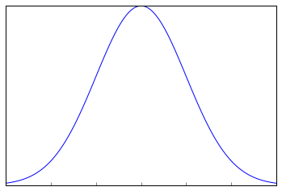
Sampling Distribution and Central Limit Theorem
Suppose, we note down the salary of any 100 random Data Science professionals in Gurgaon, calculate the mean and repeat the procedure for say like 200 times (arbitrarily).
When you plot a frequency graph of these 200 means, you are likely to get a curve similar to the one below.
This looks very much similar to the normal curve that you studied in the Descriptive Statistics. This is called Sampling Distribution or the graph obtained by plotting sample means. Let us look at a more formal description of a Sampling Distribution.
A Sampling Distribution is a probability distribution of a statistic obtained through a large number of samples drawn from a specific population.
A Sampling Distribution behaves much like a normal curve and has some interesting properties like :
The shape of the Sampling Distribution does not reveal anything about the shape of the population. For example, for the above Sampling Distribution, the population distribution may look like the below graph.

Slide 5
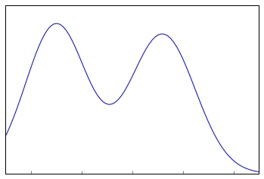
Sampling Distribution and Central Limit Theorem
Population Distribution
Sampling Distribution helps to estimate the population statistic.

Slide 6
Central Limit Theorem
It states that when plotting a sampling distribution of means, the mean of sample means will be equal to the population mean. And the sampling distribution will approach a normal distribution with variance equal to σ/√n where σ is the standard deviation of population and n is the sample size.
Points to note:
Central Limit Theorem holds true irrespective of the type of distribution of the population.
Now, we have a way to estimate the population mean by just making repeated observations of samples of a fixed size.
Greater the sample size, lower the standard error and greater the accuracy in determining the population mean from the sample mean.

Slide 7
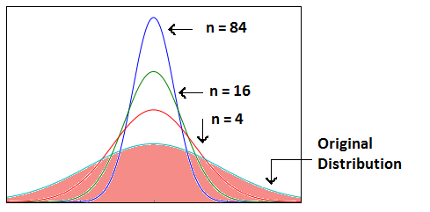
Central Limit Theorem
No matter the shape of the population distribution, be it bi-modal, right skewed etc. The shape of the Sampling Distribution will remain the same (remember the normal curve- bell shaped). This gives us a mathematical advantage to estimate the population statistic – no matter the shape of the population.
The number of samples have to be sufficient (generally more than 50) to satisfactorily achieve a normal curve distribution. Also, care has to be taken to keep the sample size fixed since any change in sample size will change the shape of the sampling distribution and it will no longer be bell shaped.
As we increase the sample size, the sampling distribution squeezes from both sides giving us a better estimate of the population statistic since it lies somewhere in the middle of the sampling distribution (generally). The below image will help you visualize the effect of sample size on the shape of distribution.
Now, since we have collected the samples and plotted their means, it is important to know where the population mean lies with respect to a particular sample mean and how confident can we be about it.

Slide 8
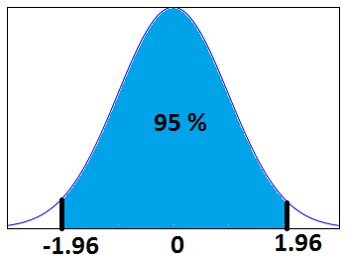
Confidence Interval
The confidence interval is a type of interval estimate from the sampling distribution which gives a range of values in which the population statistic may lie. Let us understand this with the help of an example.
We know that 95% of the values lie within 2 (1.96 to be more accurate) standard deviation of a normal distribution curve.

Slide 9
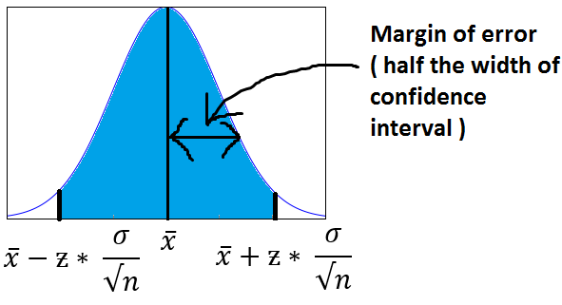
Margin of Error
It is defined as the sampling error by the surveyor or the person who collected the samples. That means, if a sample mean lies in the margin of error range then, it might be possible that its actual value is equal to the population mean and the difference is occurring by chance. Anything outside margin of error is considered statistically significant.
And it is easy to infer that the error can be both positive and negative side. The whole margin of error on both sides of the sample statistic constitutes the Confidence Interval. Numerically, C.I is twice of Margin of Error.
The below image will help you better visualize Margin of Error and Confidence Interval.
The shaded portion on horizontal axis represents the Confidence Interval and half of it is Margin of Error which can be in either direction of x (bar).

Slide 10
Margin of Error
Interesting points to note about Confidence Intervals:
Confidence Intervals can be built with difference degrees of confidence suitable to a user’s needs like 70 %, 90% etc.
Greater the sample size, smaller the Confidence Interval, i.e more accurate determination of population mean from the sample means.
There are different confidence intervals for different sample means. For example, a sample mean of 40 will have a difference confidence interval from a sample mean of 45.
By 95% Confidence Interval, we do not mean that – The probability of a population mean to lie in an interval is 95%. Instead, 95% C.I means that 95% of the Interval estimates will contain the population statistic.

Slide 11
Hypothesis Testing
Let’s consider an example
Example: Class 8th has a mean score of 40 marks out of 100. The principal of the school decided that extra classes are necessary in order to improve the performance of the class. The class scored an average of 45 marks out of 100 after taking extra classes. Can we be sure whether the increase in marks is a result of extra classes or is it just random?
Hypothesis testing lets us identify that. It lets a sample statistic to be checked against a population statistic or statistic of another sample to study any intervention etc. Extra classes being the intervention in the above example.
Hypothesis testing is defined in two terms – Null Hypothesis and Alternate Hypothesis.
Null Hypothesis being the sample statistic to be equal to the population statistic. For eg: The Null Hypothesis for the above example would be that the average marks after extra class are same as that before the classes.
Alternate Hypothesis for this example would be that the marks after extra class are significantly different from that before the class.
Hypothesis Testing is done on different levels of confidence and makes use of z-score to calculate the probability. So for a 95% Confidence Interval, anything above the z-threshold for 95% would reject the null hypothesis.

Slide 12
Hypothesis Testing
Points to be noted:
We cannot accept the Null hypothesis, only reject it or fail to reject it.
As a practical tip, Null hypothesis is generally kept which we want to disprove. For eg: You want to prove that students performed better after taking extra classes on their exam. The Null Hypothesis, in this case, would be that the marks obtained after the classes are same as before the classes.

